Slide 1

What, Why and How of Probability.
5CS037-Concepts and Technologies of AI.
Week03, Lecture03
Introduction to Probability for Machine Learning.
Siman Giri

Slide 2
1. What, Why and How of Probability.

Slide 3

1.1 What is Probability?
We make decisions based on uncertainty everyday.
Should you buy an extended warranty for your new mac-book?
Should you allow 45 min. to get to your 9:00 AM class or 35 min. is enough?
If an artificial heart has four key parts, how likely is that at least one will fail?
Thus, in a process where multiple possible outcomes are possible; How do you make decision?
When the process is repeated a large number of times, each outcome occurs with a relative frequency, or probability
If a particular outcome occurs more often, we say it is more probable.
Is probability the mathematics; used to quantify the likelihood of an event may occur….
Probability is the systematic study of uncertainty.

Slide 4


1.2 Why Probability?
The term probability is the measure of one’s belief in the occurrence of a future event.
This is a meaningful and practical interpretation of probability but we further seek a clearer understanding of its context and how it is measured or it is estimated and how it helps in making inferences?
Probability arises in two contexts
In actual repeated experiments
Example: You record the color of 1,000 cars driving by. 57 of them are green. You estimate the probability of a car being green as 57/1,000 = 0.057.
In idealized conceptions of a repeated process
Example: You consider the behavior of an unbiased six-sided die. The expected probability of rolling a 5 is 1/6 = 0.1667.
Example: You need a model for how people’s heights are distributed. You choose a normal distribution to represent the expected relative probabilities.
Probability theory provides a mathematical framework for representing and quantifying uncertain quantities.

Slide 5

1.3 How are Probability determined?
Probability statements are frequently encountered in newspapers, magazines, advertising etc.
What is the basis for these probability statements?
In most cases, reasonable estimates are based on observation and analysis.
In general, if a probability is stated, it is based on one of the following approaches:
The classical approach: This approach is appropriate only for modelling chance experiments with equally likely equipment.
The relative frequency approach: An estimate is based on an accumulation of experimental results. This estimate, usually derived empirically, presumes a replicable chance experiment.
The subjective approach: In this case, the probability represents an individual’s judgment based on facts combined with personal evaluation of other information.

Slide 6
Summary!!!
To estimate (quantify) the uncertainty of an event related to some process; we can modeled the behavior of a process based on observed outcomes, such that an inference could be made on future events.
So far we have introduced following terms:
process, event, outcomes, relative frequency, likelihood, estimate, model, distributed
Objective of this week-define above terms in the context of probability theory.
When we speak about probability, we often refer to the probability of an event of uncertain nature taking place.
For e.g. What is the probability of rain next Tuesday?
Therefore, in order to discuss probability theory formally, we must first clarify what the possible events are to which we would like to attach probability.

Slide 7
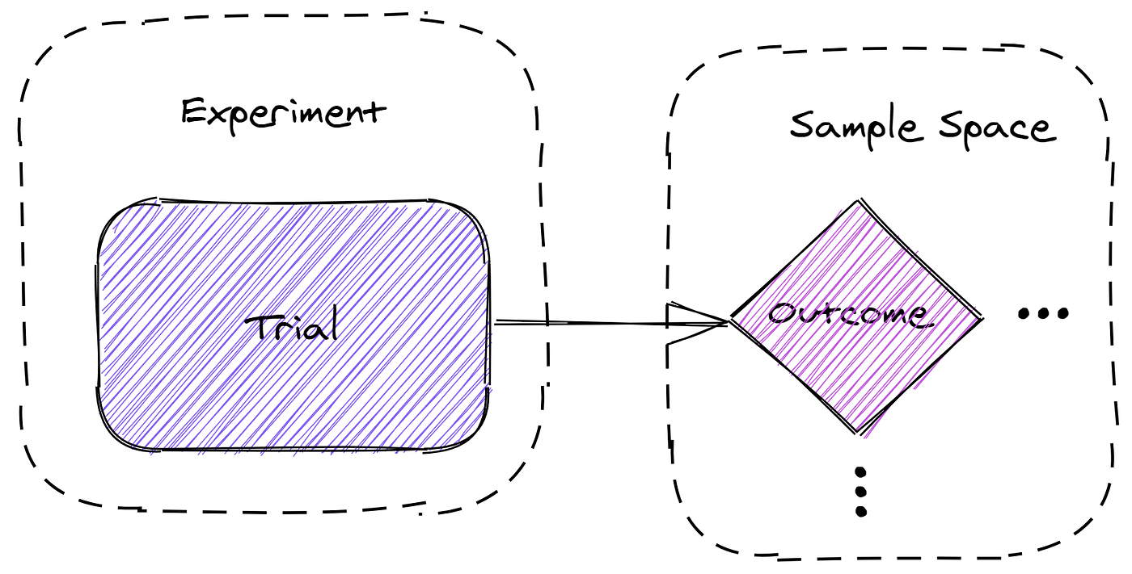
2. Elements of Probabilistic Space.
Experiments(Chance), Sample Space, Events and Probability measure.

Slide 8
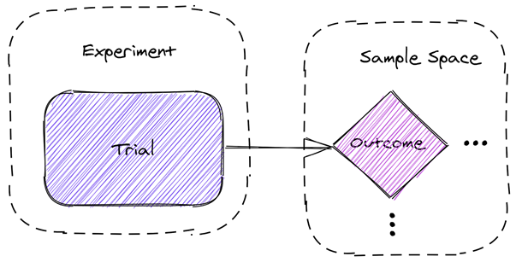
2.1 Experiment(chance).
An experiment is the process by which an observation is made.
A chance experiment is any activity or situation in which there is uncertainty about which of the two or more possible outcomes will result.

Slide 9
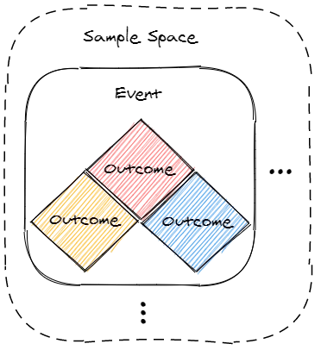
2.2 Probability Space.
A probability space is a triple (Ω, E,P) consisting of:
A sample space Ω/S, which contains all possible outcomes of the experiment.
A set of events E,
A probability measure P that assigns probabilities to the events in E.

Slide 10
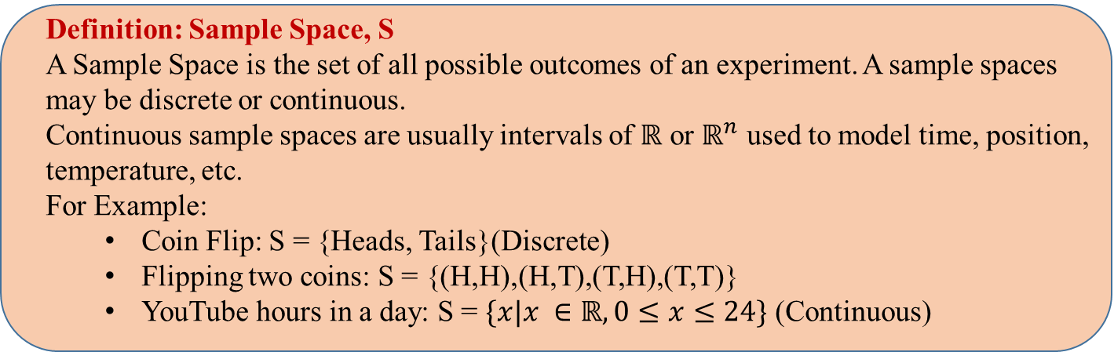
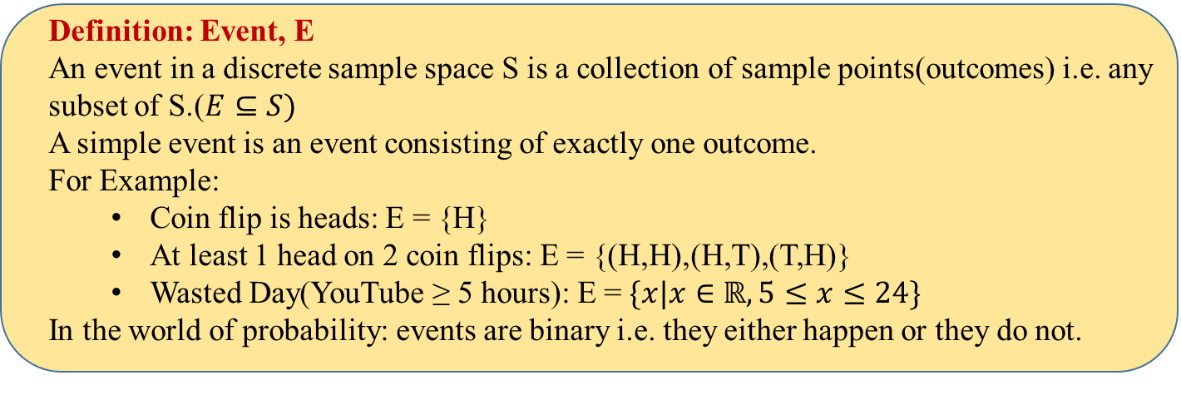
2.2 Probability Space.

Slide 11
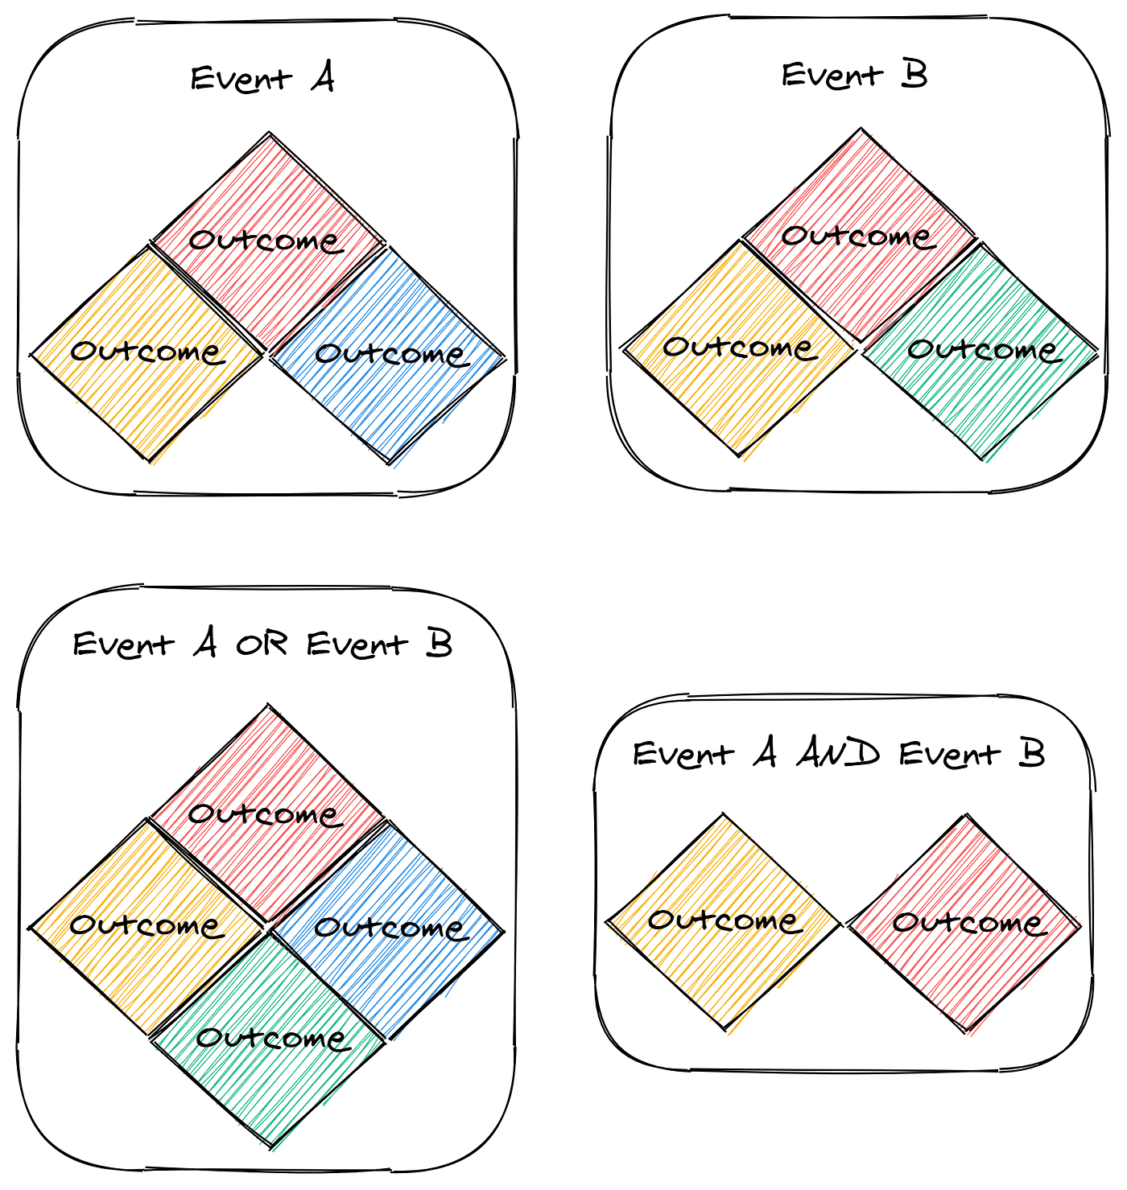
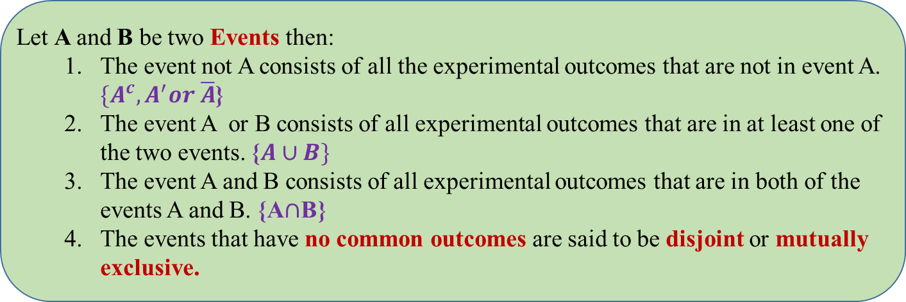
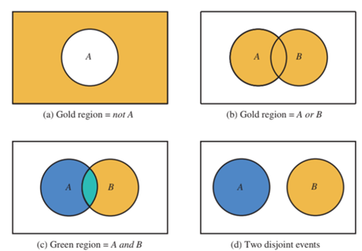
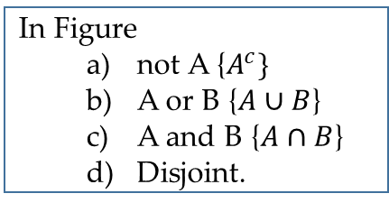
2.3 Events and Sets.
In Figure
not A {$A^{c}\}$
A or B {$A∪B$}
A and B {$A∩B$}
Disjoint.

Slide 12
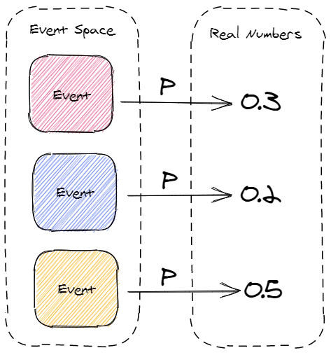
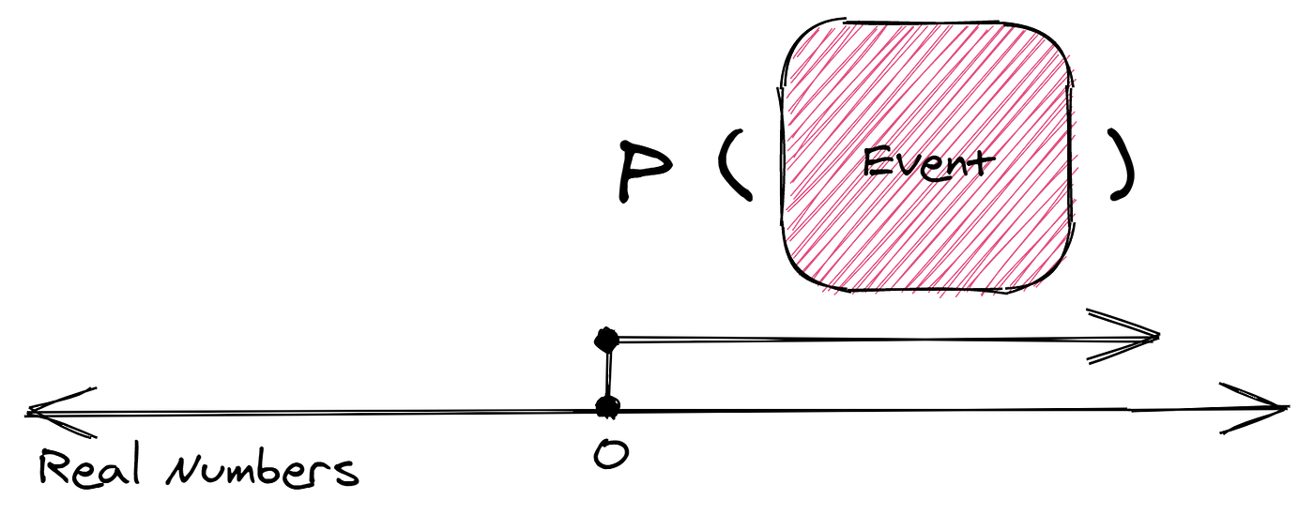
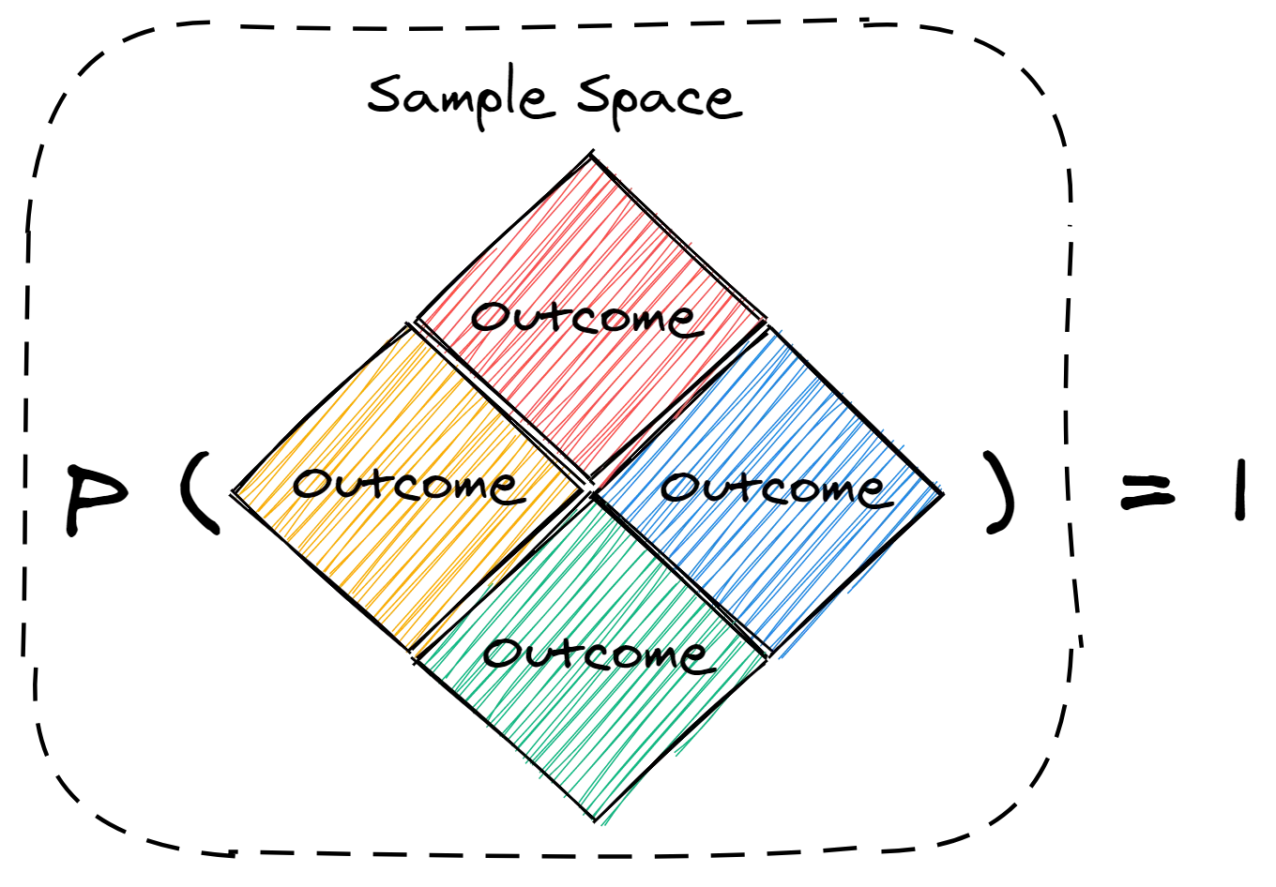
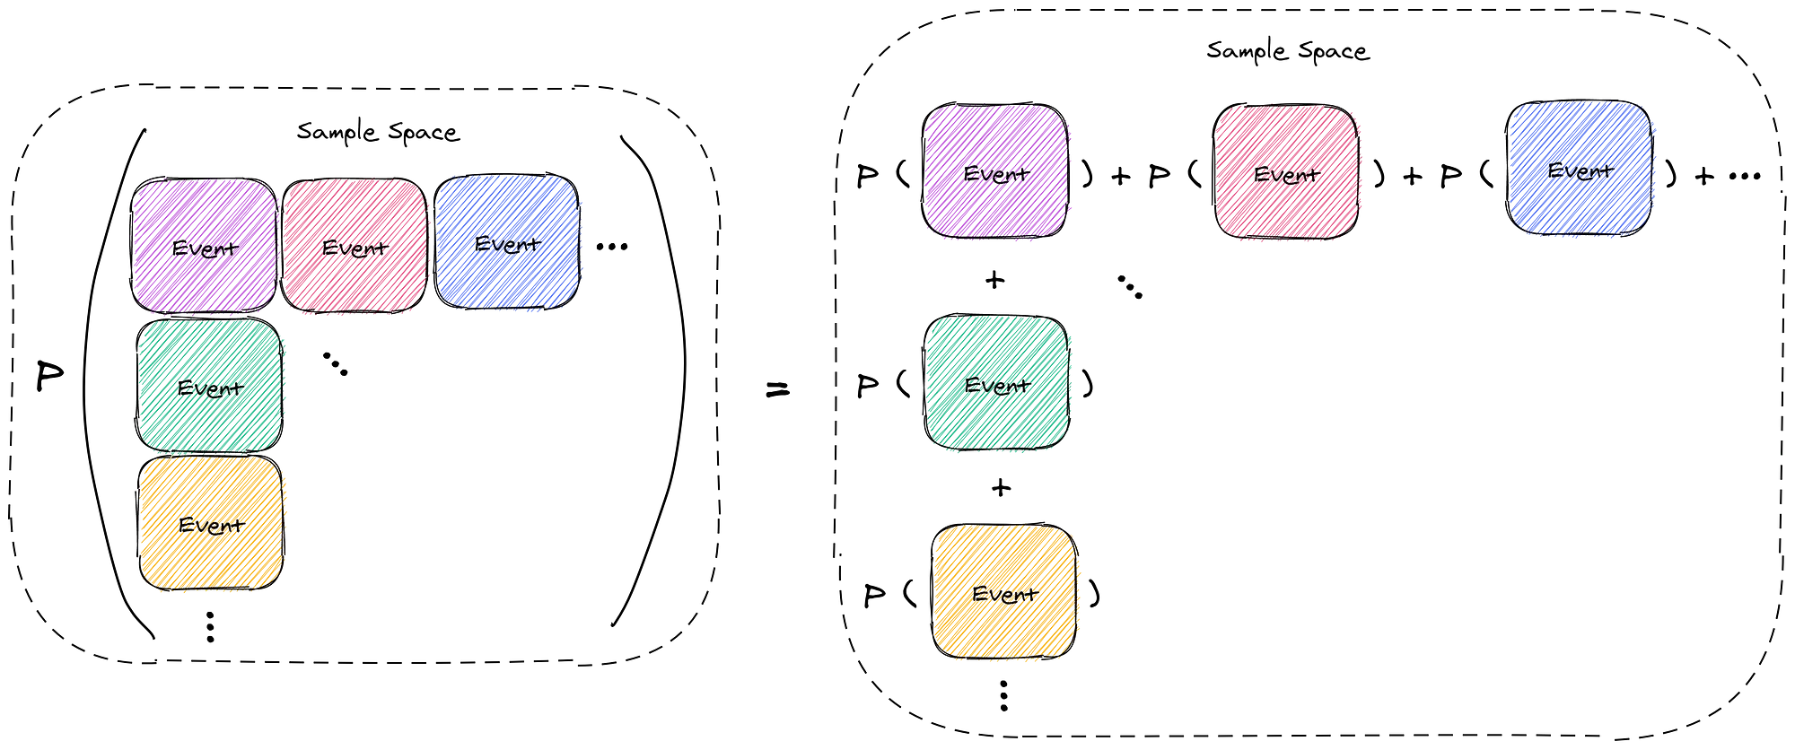
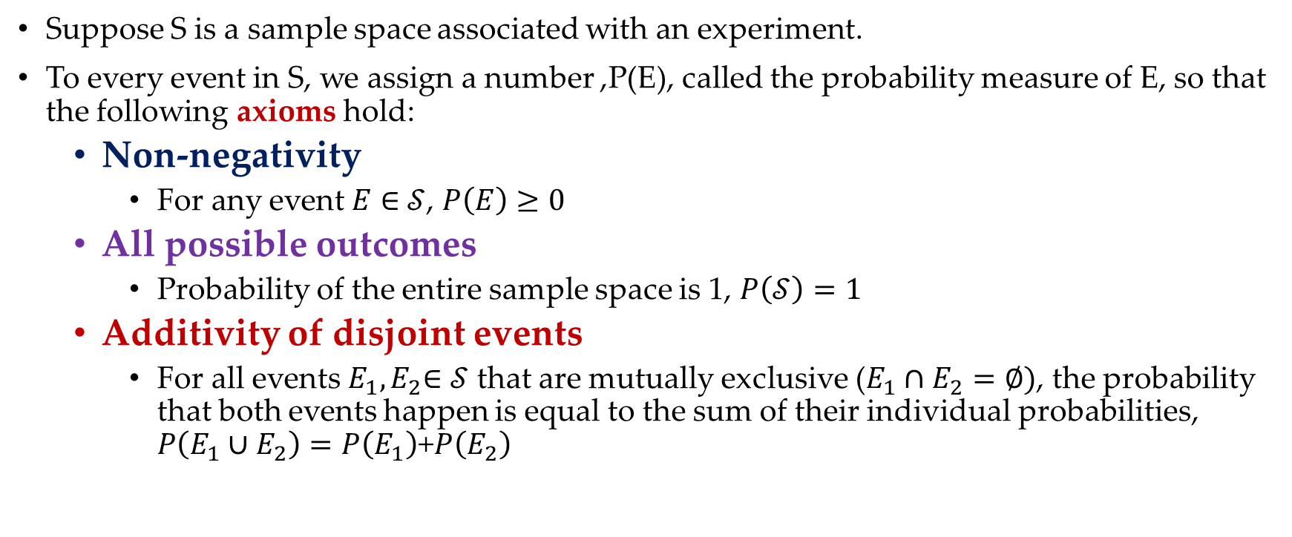
2.4 Probability Measure.
Suppose S is a sample space associated with an experiment.
To every event in S, we assign a number ,P(E), called the probability measure of E, so that the following axioms hold:
Non-negativity
For any event $E$ ∈ $𝒮$, $P\left(E\right)≥0$
All possible outcomes
Probability of the entire sample space is 1, $P\left(𝒮\right)=1$
Additivity of disjoint events
For all events $E_{1}{,E}_{2}$∈ $𝒮$ that are mutually exclusive ($E_{1}∩E_{2}=∅)$, the probability that both events happen is equal to the sum of their individual probabilities, $P\left(E_{1}∪E_{2}\right)=P\left(E_{1}\right)$+$P\left(E_{2}\right)$

Slide 13
2.5 Choosing an Sample Space.
different elements of the sample space should be distinct and mutually exclusive so that when the experiment is carried out, there is a unique outcome.
the sample space chosen for a probabilistic model must be collectively exhaustive, in the sense that no matter what happens in the experiment, we always obtain an outcome that has been included in the sample space.
the sample space should have enough detail to distinguish between all outcomes of interest to the modeler, while avoiding irrelevant details.

Slide 14
3.Calculating the Probability of an Discrete Event.

Slide 15

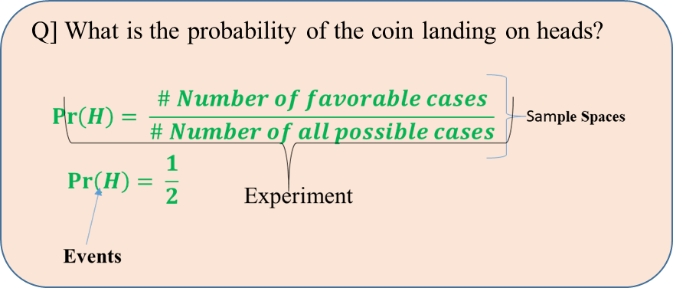
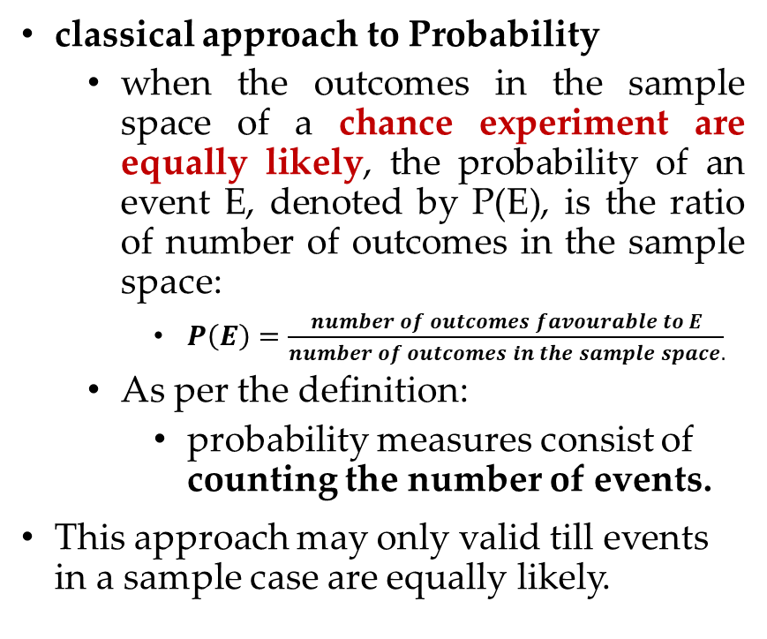
3.1 Calculating Probability – Classical Approach.
classical approach to Probability
when the outcomes in the sample space of a chance experiment are equally likely, the probability of an event E, denoted by P(E), is the ratio of number of outcomes in the sample space:
$P\left(E\right)=\frac{number of outcomes favourable to E}{number of outcomes in the sample space.}$
As per the definition:
probability measures consist of counting the number of events.
This approach may only valid till events in a sample case are equally likely.
Flip a Coin

Slide 16
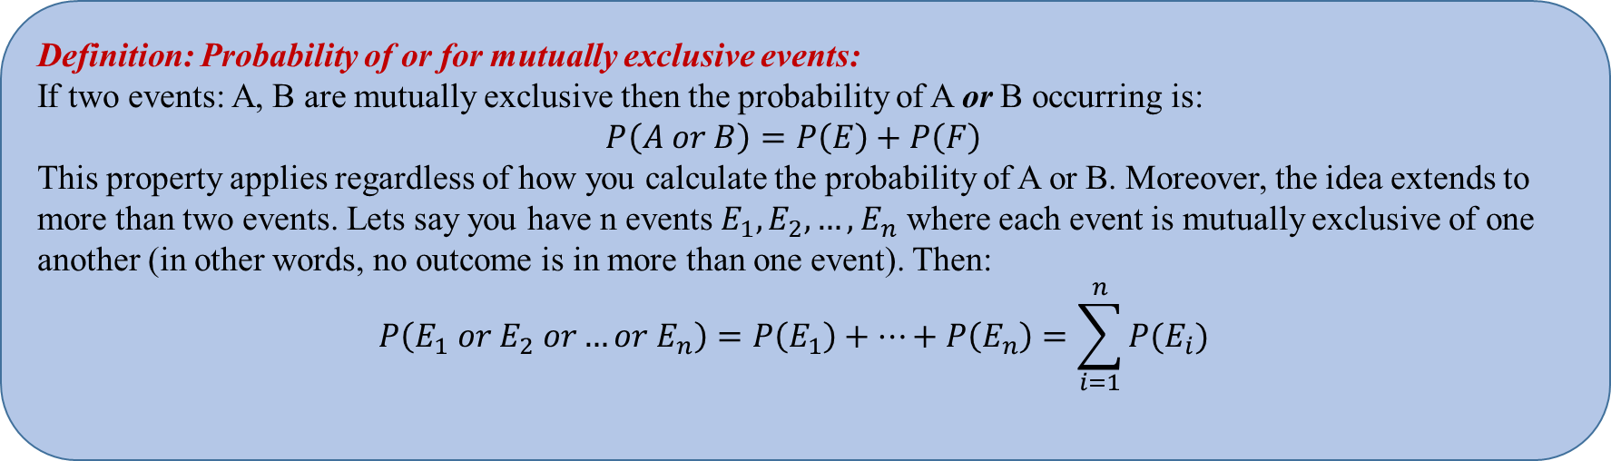
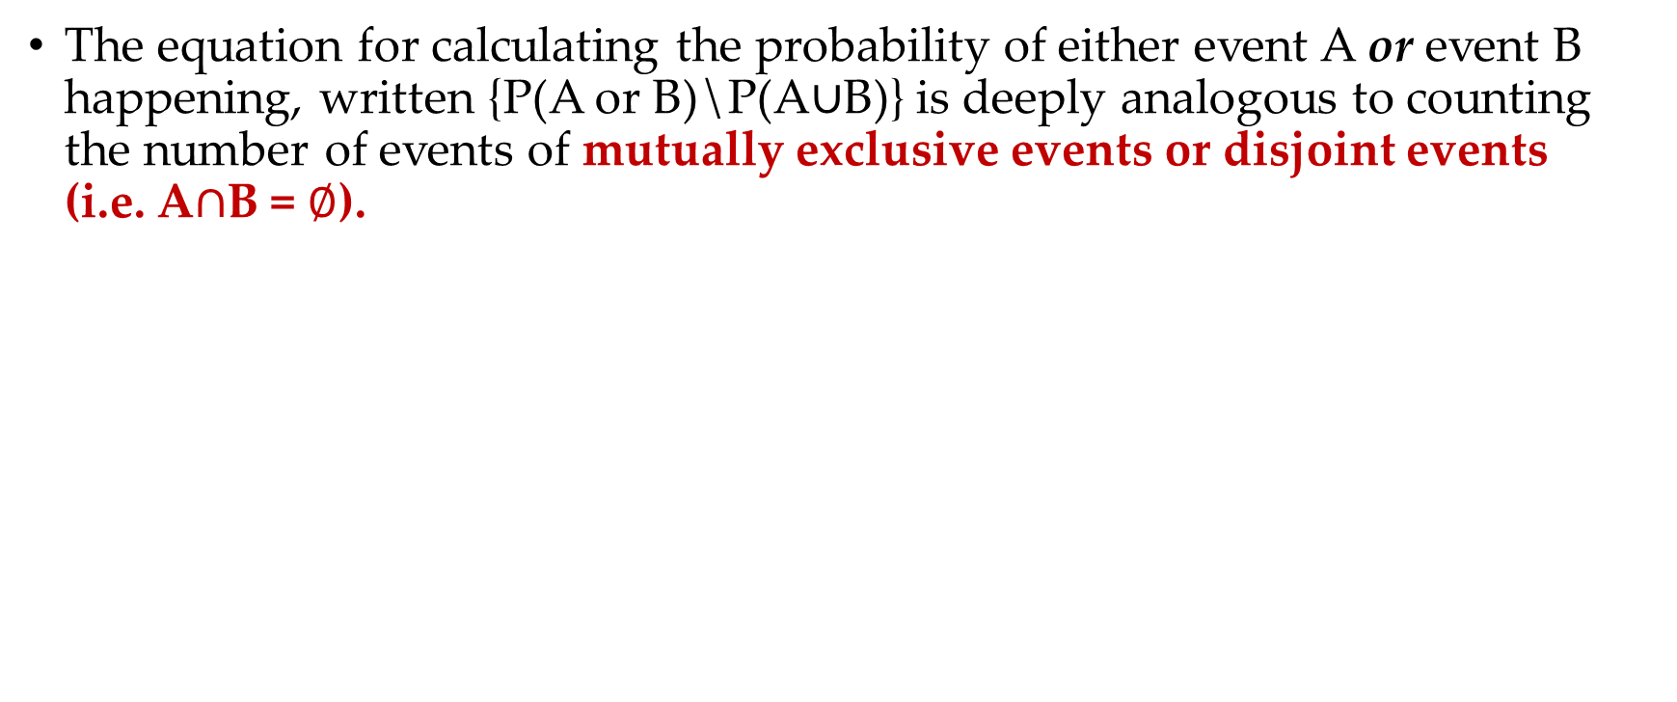
3.2 Calculating Probability of “or”
The equation for calculating the probability of either event A or event B happening, written {P(A or B)\P(A$∪$B)} is deeply analogous to counting the number of events of mutually exclusive events or disjoint events (i.e. A$∩$B = $∅$).

Slide 17
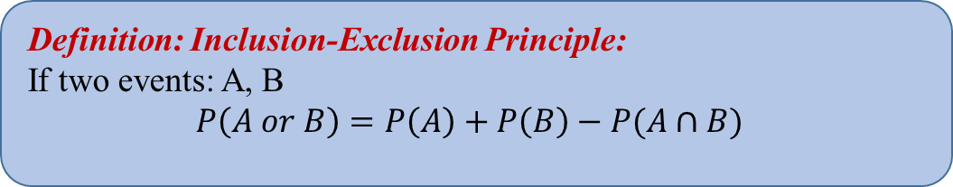
3.2 Calculating Probability of “or”
Unfortunately, not all events are mutually exclusive. If you want to calculate P(C or D) where the events C and D are not mutually exclusive you can not simply add the probabilities.
Why?
If two events are not mutually exclusive, simply adding their probabilities double counts the probability of any outcome which is in both events.
There is a formula for calculating or of two non-mutually exclusive events: it is called the "inclusion exclusion" principle.
the inclusion exclusion principle also applies for mutually exclusive events. If two events are mutually exclusive P(E and F)=0 since its not possible for both E and F to occur. As such the formula P(E)+P(F)−P(E and F) reduces to P(E)+P(F).

Slide 18
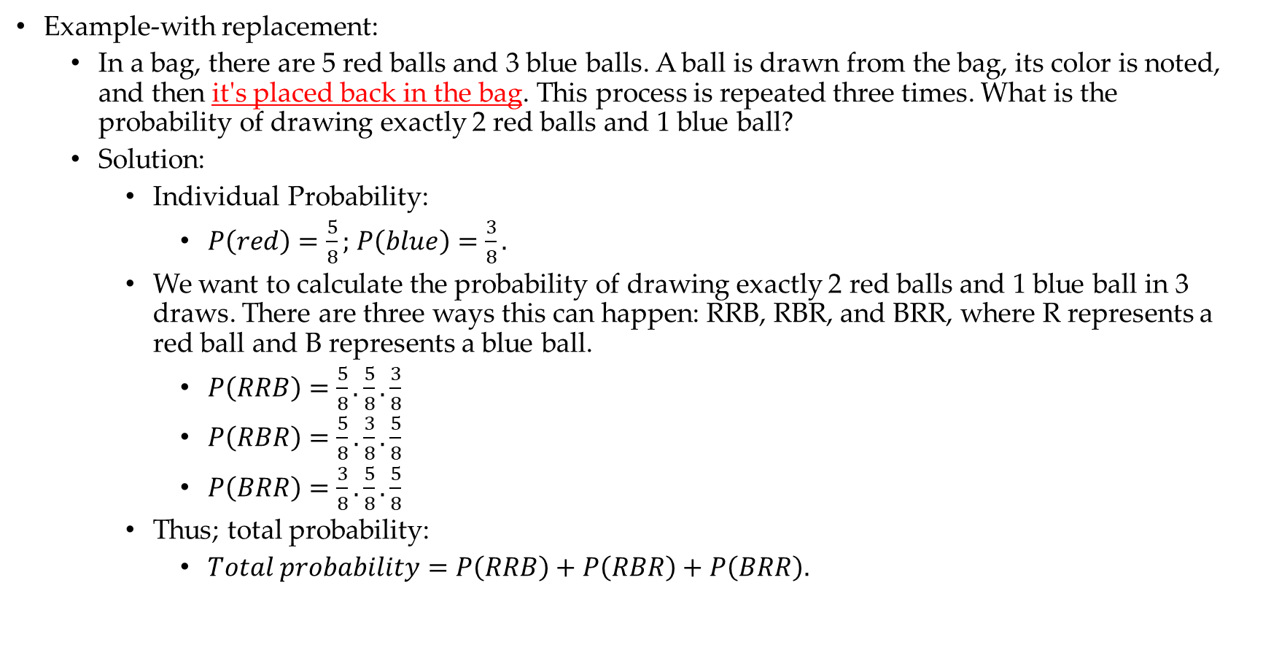
3.4 Probability: with and without replacement.
Example-with replacement:
In a bag, there are 5 red balls and 3 blue balls. A ball is drawn from the bag, its color is noted, and then it's placed back in the bag. This process is repeated three times. What is the probability of drawing exactly 2 red balls and 1 blue ball?
Solution:
Individual Probability:
$P\left(red\right)=\frac{5}{8};$ $P\left(blue\right)=\frac{3}{8}.$
We want to calculate the probability of drawing exactly 2 red balls and 1 blue ball in 3 draws. There are three ways this can happen: RRB, RBR, and BRR, where R represents a red ball and B represents a blue ball.
$P\left(RRB\right)=\frac{5}{8}.\frac{5}{8}.\frac{3}{8}$
$P\left(RBR\right)=\frac{5}{8}.\frac{3}{8}.\frac{5}{8}$
$P\left(BRR\right)=\frac{3}{8}.\frac{5}{8}.\frac{5}{8}$
Thus; total probability:
$Total probability=P\left(RRB\right)+P\left(RBR\right)+P\left(BRR\right).$

Slide 19
3.5 Probability: with and without replacement.
Example-without replacement (Home Task):
In a bag, there are 5 red balls and 3 blue balls. A ball is drawn from the bag, its color is noted, and then it's not placed back in the bag. This process is repeated three times. What is the probability of drawing exactly 2 red balls and 1 blue ball?
Solution:

Slide 20
3.2 Calculating Probability: Example.
Solve it:
We have a committee of n = 10 people and we want to choose a chairperson, a vice-chairperson and a treasurer. Suppose that 6 of the members of the committee are male and 4 of the members are female. What is the probability that the three executives selected are all male?
Solutions:
Favorable events: {C, VC, T: Male.}
Sample space: {(M1,M2,M3),(M2, M1,M3),……(F3,F4,F1)}
P = ?
Solving for probability requires counting of an total events in sample space, which can be little complicated depending on the process/experiment and probability desired.
Let’s take a small detour and revise some important concepts for Counting Theory.

Slide 21
A. Counting

Slide 22
A.1 Basic Counting Rules.
Addition and Multiplication Principles:
“Addition Principle”:
If the outcome of an experiment can either be drawn from event of set A or set B, where none of the outcomes in set A are the same as any of the outcomes in set B (called mutual exclusion), then there are
|A or B|=|A|+|B| possible outcomes of the experiment.
To illustrate the addition principle:
if a restaurant offers (presuming no course is counted twice):
5 main courses with chicken,
6 main courses with mutton,
and 12 vegetarian main courses,
then the total possible number of main courses is
5 + 6 + 12 = 23.

Slide 23
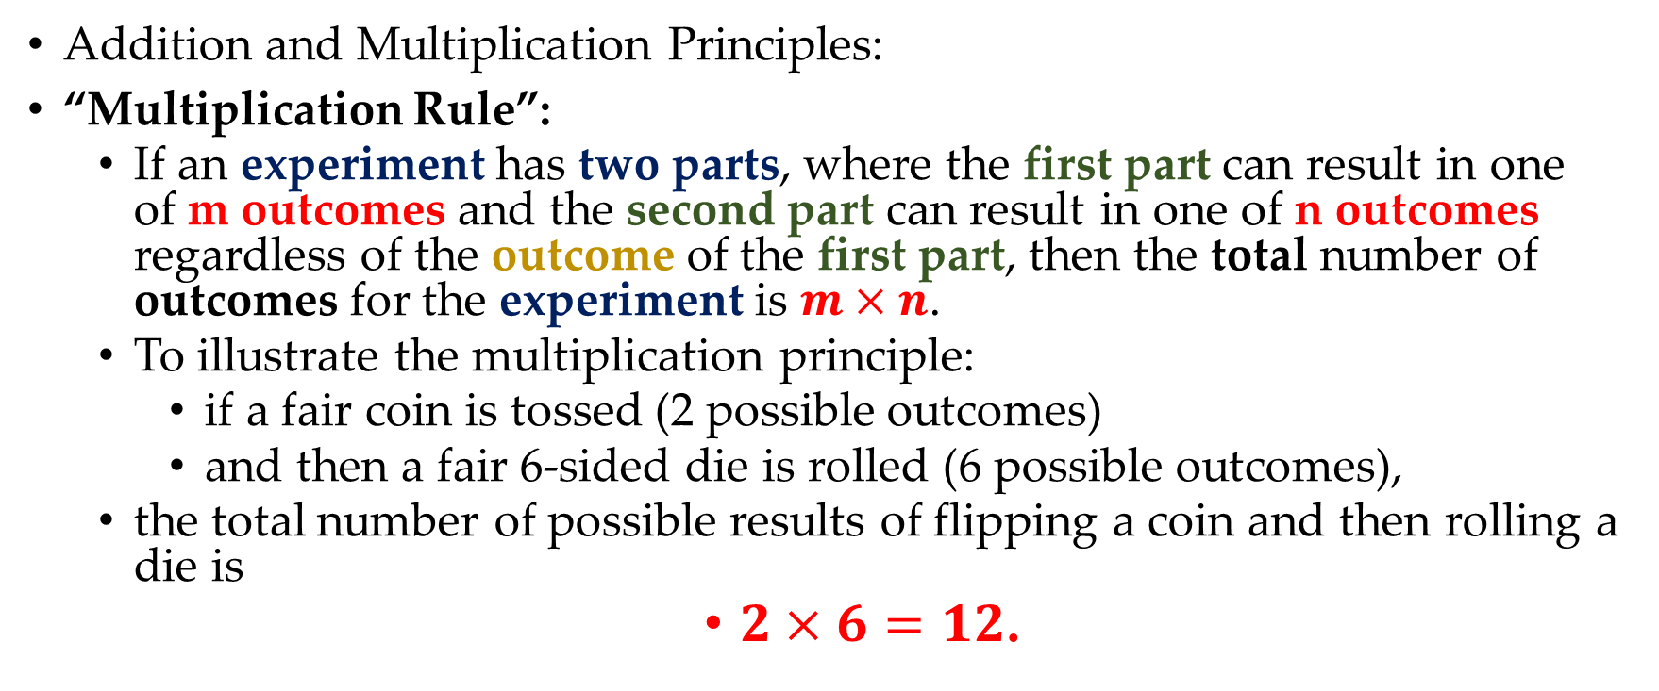
A.1 Basic Counting Rules.
Addition and Multiplication Principles:
“Multiplication Rule”:
If an experiment has two parts, where the first part can result in one of m outcomes and the second part can result in one of n outcomes regardless of the outcome of the first part, then the total number of outcomes for the experiment is $m×n$.
To illustrate the multiplication principle:
if a fair coin is tossed (2 possible outcomes)
and then a fair 6-sided die is rolled (6 possible outcomes),
the total number of possible results of flipping a coin and then rolling a die is
$2×6=12$.

Slide 24
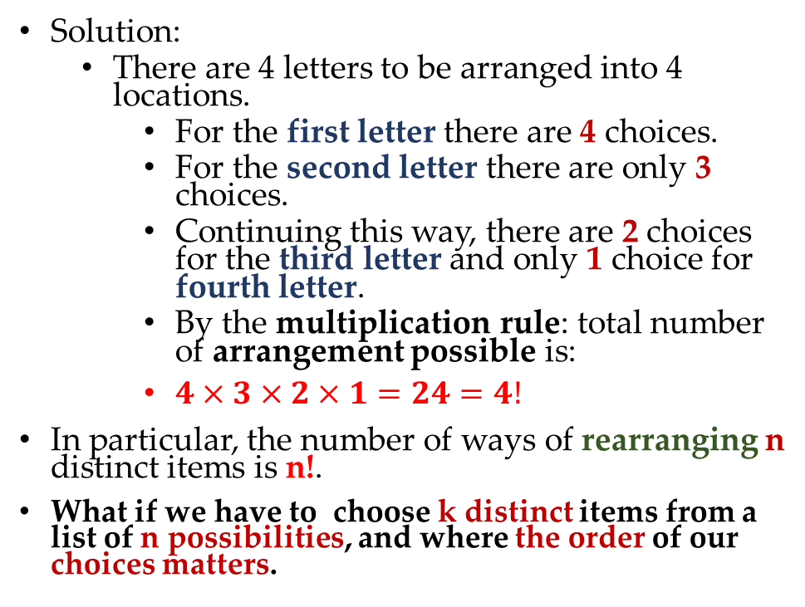
A.2 Counting Rules: Combinatorics.
Many counting problems can be approached from the basic building blocks described in the first section: Counting Rules.
However some counting problems are so ubiquitous in the world of probability that it is worth knowing a few higher level counting abstractions.
Permutations and Combinations.
Example:
Determine the number of ways we can order the objects{A,B,C,D}.
Solution:
There are 4 letters to be arranged into 4 locations.
For the first letter there are 4 choices.
For the second letter there are only 3 choices.
Continuing this way, there are 2 choices for the third letter and only 1 choice for fourth letter.
By the multiplication rule: total number of arrangement possible is:
$4×3×2×1=24=4!$
In particular, the number of ways of rearranging n distinct items is n!.
What if we have to choose k distinct items from a list of n possibilities, and where the order of our choices matters.

Slide 25
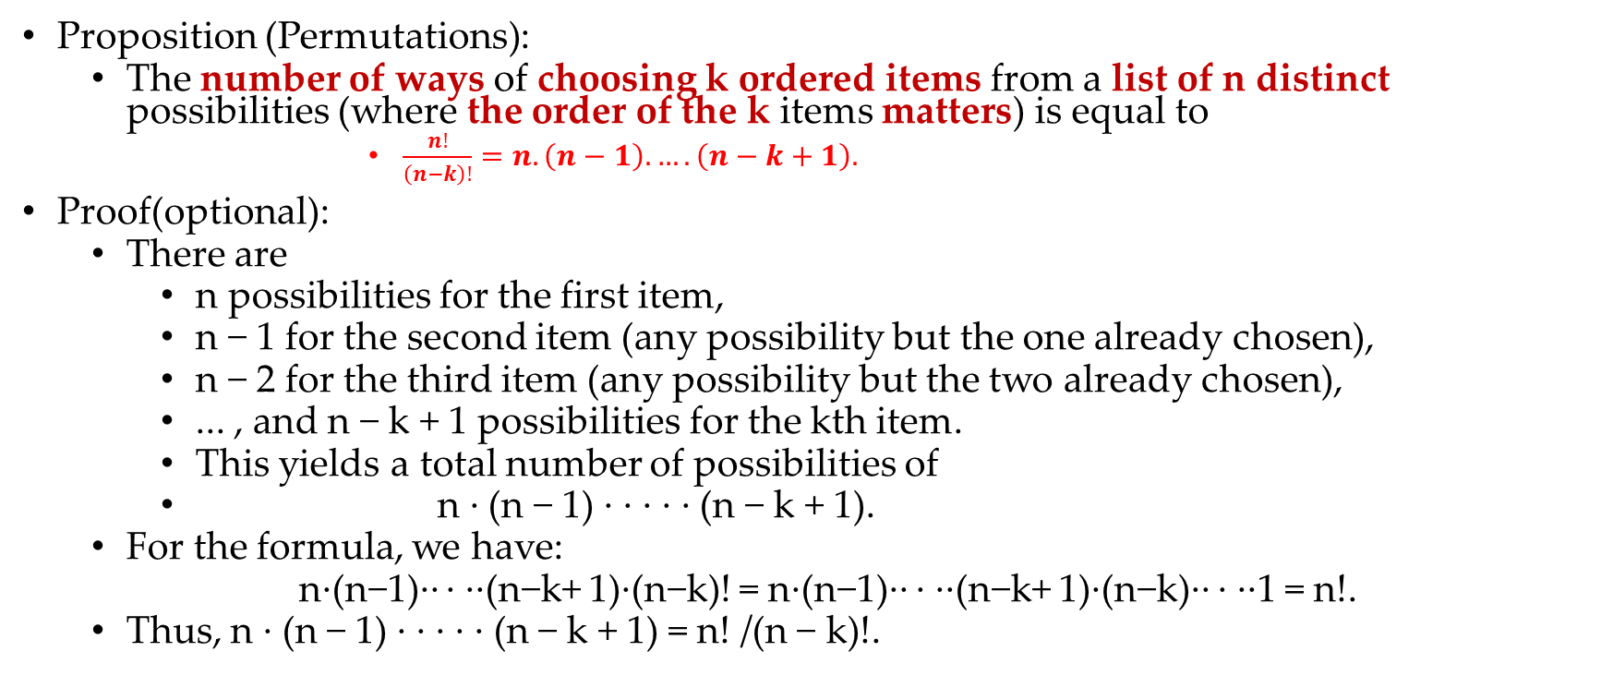
A.2 Counting Rules: Permutations.
Proposition (Permutations):
The number of ways of choosing k ordered items from a list of n distinct possibilities (where the order of the k items matters) is equal to
$\frac{n!}{\left(n−k\right)!}=n.\left(n−1\right). ….\left(n−k+1\right).$
Proof(optional):
There are
n possibilities for the first item,
n − 1 for the second item (any possibility but the one already chosen),
n − 2 for the third item (any possibility but the two already chosen),
... , and n − k + 1 possibilities for the kth item.
This yields a total number of possibilities of
n · (n − 1) · · · · · (n − k + 1).
For the formula, we have:
n·(n−1)·· · ··(n−k+ 1)·(n−k)! = n·(n−1)·· · ··(n−k+ 1)·(n−k)·· · ··1 = n!.
Thus, n · (n − 1) · · · · · (n − k + 1) = n! /(n − k)!.

Slide 26
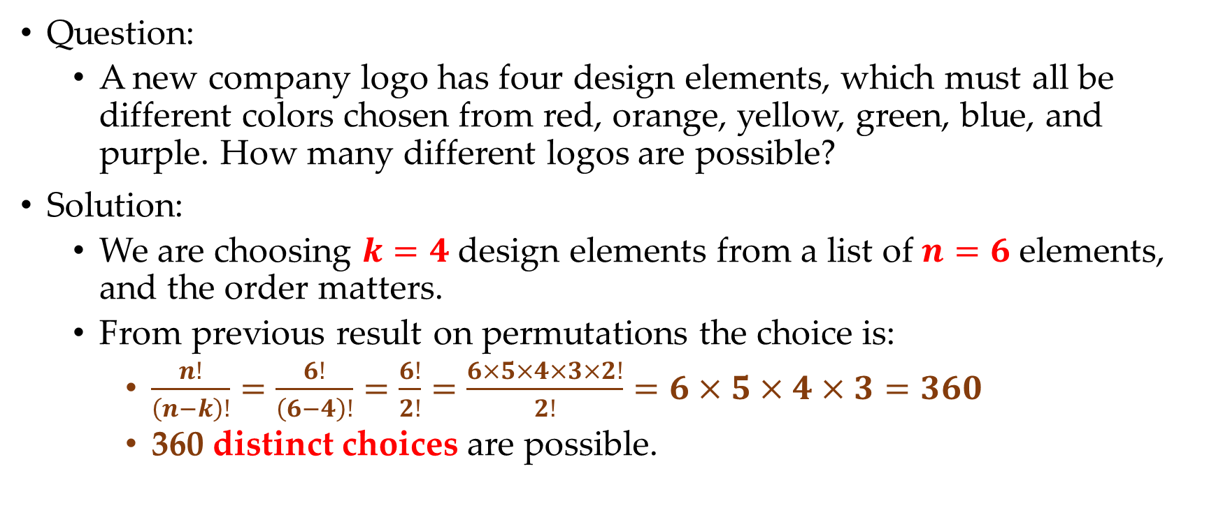
A.2.1 Permutations: Example.
Question:
A new company logo has four design elements, which must all be different colors chosen from red, orange, yellow, green, blue, and purple. How many different logos are possible?
Solution:
We are choosing $k=4$ design elements from a list of $n=6$ elements, and the order matters.
From previous result on permutations the choice is:
$\frac{n!}{\left(n−k\right)!}=\frac{6!}{\left(6−4\right)!}=\frac{6!}{2!}=\frac{6×5×4×3×2!}{2!}=6×5×4×3=360$
360 distinct choices are possible.

Slide 27
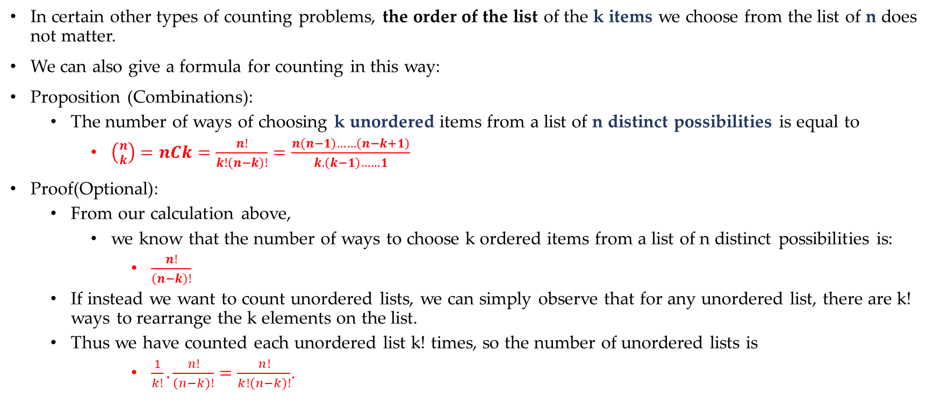
A.3 Counting Rules: Combinations.
In certain other types of counting problems, the order of the list of the k items we choose from the list of n does not matter.
We can also give a formula for counting in this way:
Proposition (Combinations):
The number of ways of choosing k unordered items from a list of n distinct possibilities is equal to
$\left({n \atop k}\right)=nCk=\frac{n!}{k!\left(n−k\right)!}=\frac{n\left(n−1\right)……\left(n−k+1\right)}{k.\left(k−1\right)……1}$
Proof(Optional):
From our calculation above,
we know that the number of ways to choose k ordered items from a list of n distinct possibilities is:
$\frac{n!}{\left(n−k\right)!}$
If instead we want to count unordered lists, we can simply observe that for any unordered list, there are k! ways to rearrange the k elements on the list.
Thus we have counted each unordered list k! times, so the number of unordered lists is
$\frac{1}{k!}.\frac{n!}{\left(n−k\right)!}=\frac{n!}{k!\left(n−k\right)!}$.

Slide 28
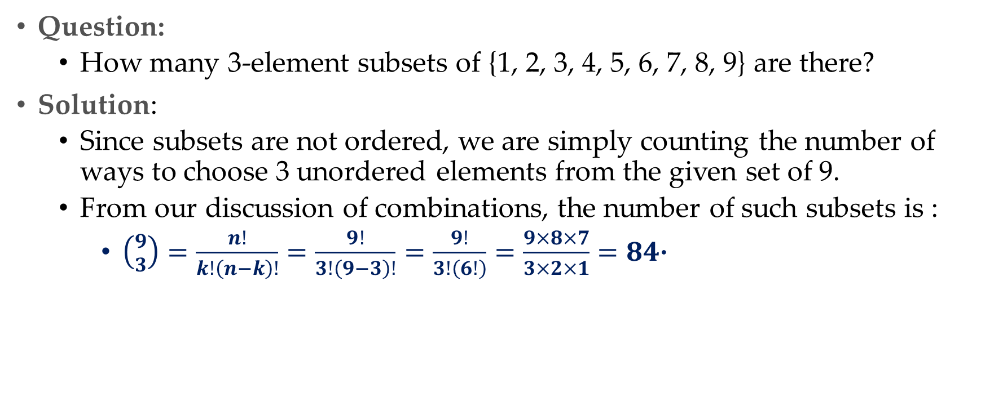
A.3.1Combinations:Example.
Question:
How many 3-element subsets of {1, 2, 3, 4, 5, 6, 7, 8, 9} are there?
Solution:
Since subsets are not ordered, we are simply counting the number of ways to choose 3 unordered elements from the given set of 9.
From our discussion of combinations, the number of such subsets is :
$\left({9 \atop 3}\right)=\frac{n!}{k!\left(n−k\right)!}=\frac{9!}{3!\left(9−3\right)!}=\frac{9!}{3!\left(6!\right)}=\frac{9×8×7}{3×2×1}=84$·

Slide 29
4. Rules of Probabilities.

Slide 30
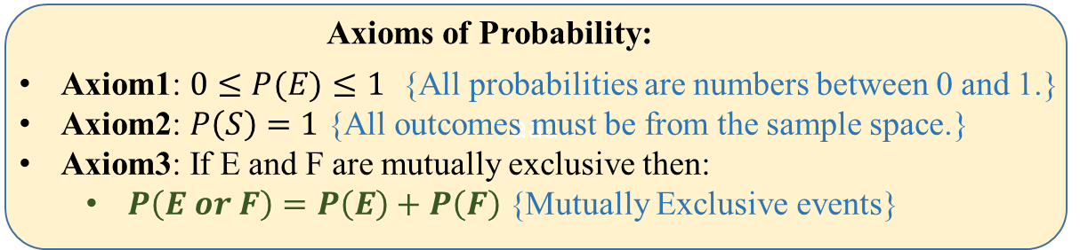
4.1 Axioms of Probability!!!
Discussed in slide-12:

Slide 31
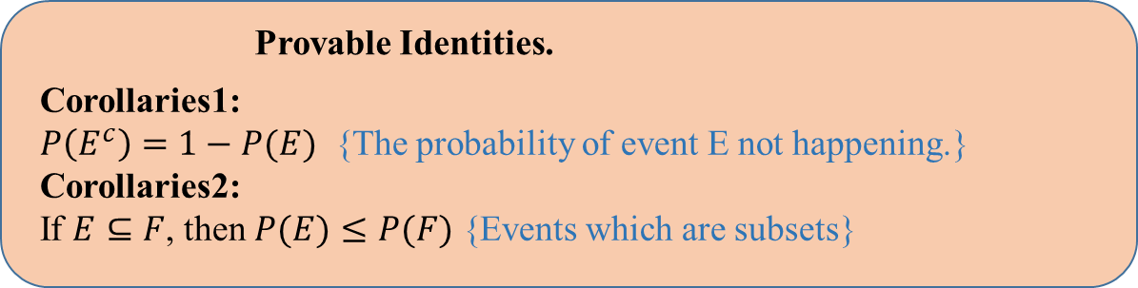
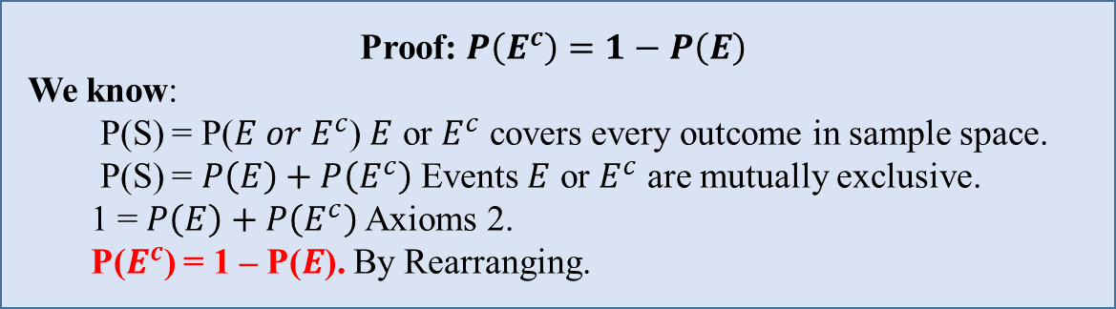
4.2 Corollaries of Probability!!!
Following are the extension to the rule of probability directly provable from the three axioms:

Slide 32
5.Conditional Probability

Slide 33
4.1 Conditional Probability: Intuition.
Conditional probability provides us with a way to reason about the outcome of an experiment, based on partial information.
Here are some examples of situations we have in mind:
In an experiment involving two successive rolls of a die, you are told that the sum of the two rolls is 9. How likely is it that the first roll was a 6?
In a word guessing game, the first letter of the word is a “t”. What is the likelihood that the second letter is an “h”?
How likely is it that a person has a disease given that a medical test was negative?
In more precise terms, given an experiment, a corresponding sample space, and a probability law can we answer following:
"what is the chance of an event E happening given that I have already observed some other event F”
thus seek to construct a new probability law, which takes into account this knowledge and which, for any event F, gives us the conditional probability of E given F, denoted by P(E | F).
It is a critical idea in machine learning and probability because it allows us to update our probabilities in the face of new evidence.

Slide 34
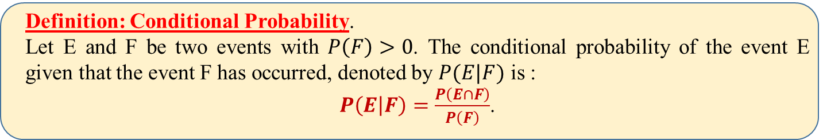
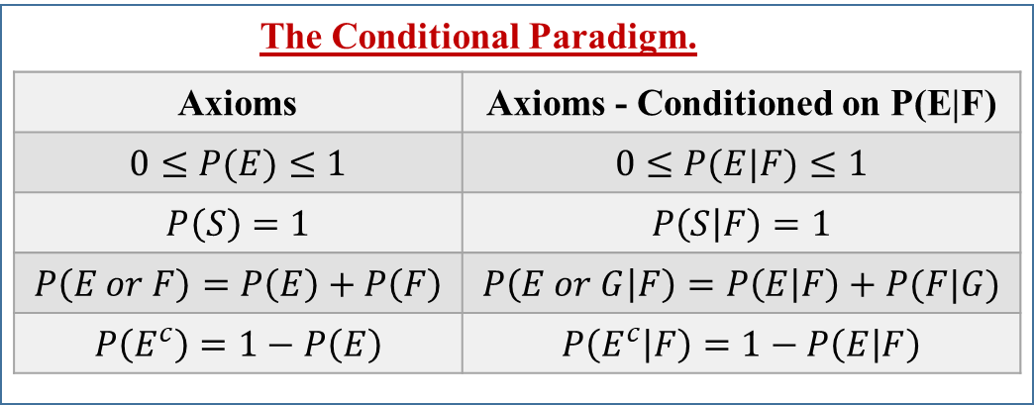
4.2 Conditional Probability: Definition.

Slide 35
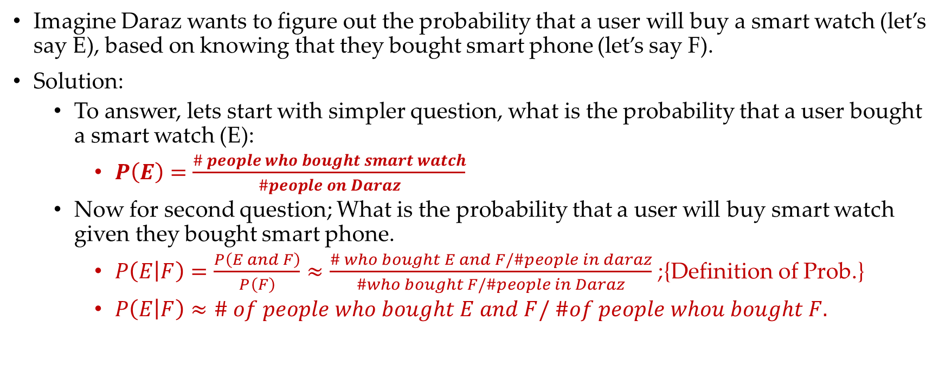
4.3 Conditional Probability: Example.
Imagine Daraz wants to figure out the probability that a user will buy a smart watch (let’s say E), based on knowing that they bought smart phone (let’s say F).
Solution:
To answer, lets start with simpler question, what is the probability that a user bought a smart watch (E):
$P\left(E\right)=\frac{\# people who bought smart watch}{\#people on Daraz}$
Now for second question; What is the probability that a user will buy smart watch given they bought smart phone.
$P\left(E | F\right)=\frac{P\left(E and F\right)}{P\left(F\right)}≈\frac{\# who bought E and F/\#people in daraz}{\#who bought F/\#people in Daraz}$ ;{Definition of Prob.}
$P\left(E | F\right)≈\# of people who bought E and F/ \#of people whou bought F.$

Slide 36
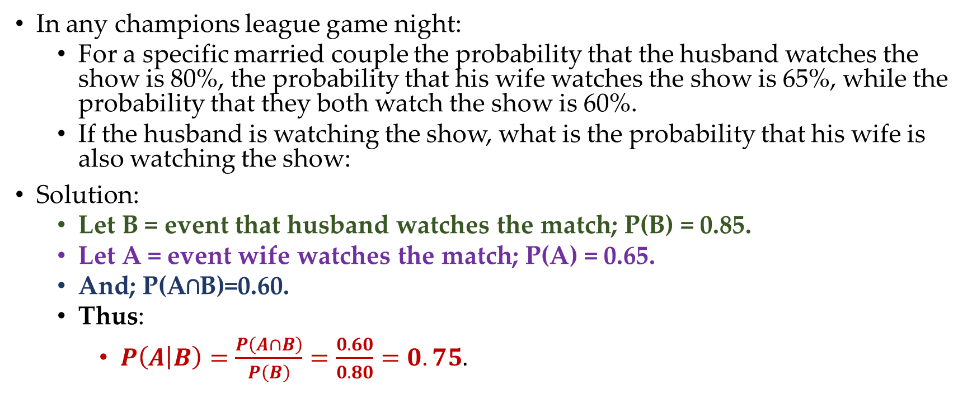
4.3 Conditional Probability: Example.
In any champions league game night:
For a specific married couple the probability that the husband watches the show is 80%, the probability that his wife watches the show is 65%, while the probability that they both watch the show is 60%.
If the husband is watching the show, what is the probability that his wife is also watching the show:
Solution:
Let B = event that husband watches the match; P(B) = 0.85.
Let A = event wife watches the match; P(A) = 0.65.
And; P(A∩B)=0.60.
Thus:
$P\left(A | B\right)=\frac{P\left(A∩B\right)}{P\left(B\right)}=\frac{0.60}{0.80}=0.75.$

Slide 37
5. Independence

Slide 38
5.1 Independence: Intuition.
We have introduced the conditional probability P(E | F) to capture the partial information that event F provides about event E.
An interesting and important special case arises when the occurrence of F provides no information and does not alter the probability that E has occurred, i.e. in such case:
Two events are said to be independent if knowing the outcome of one event does not change your belief about whether or not the other event will occur.
For example, you might say that two separate dice rolls are independent of one another: the outcome of the first dice gives you no information about the outcome of the second -- and vice versa.

Slide 39
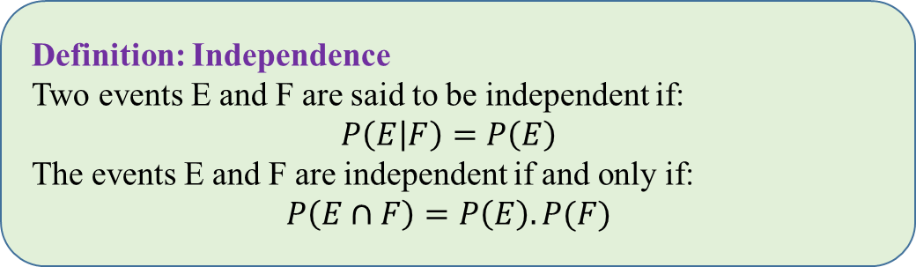
5.2 Independence: Definition.
Independence is often easy to grasp intuitively.
For example, if the occurrence of two events is governed by distinct and non interacting physical processes, such events will turn out to be independent.
On the other hand, independence is not easily visualized in terms of the sample space.
A common first thought is that two events are independent if they are disjoint, but in fact the opposite is true:
two disjoint events A and B with
P(A) > 0 and P(B) > 0 are never independent,
since their intersection A ∩ B is empty and has probability 0.

Slide 40
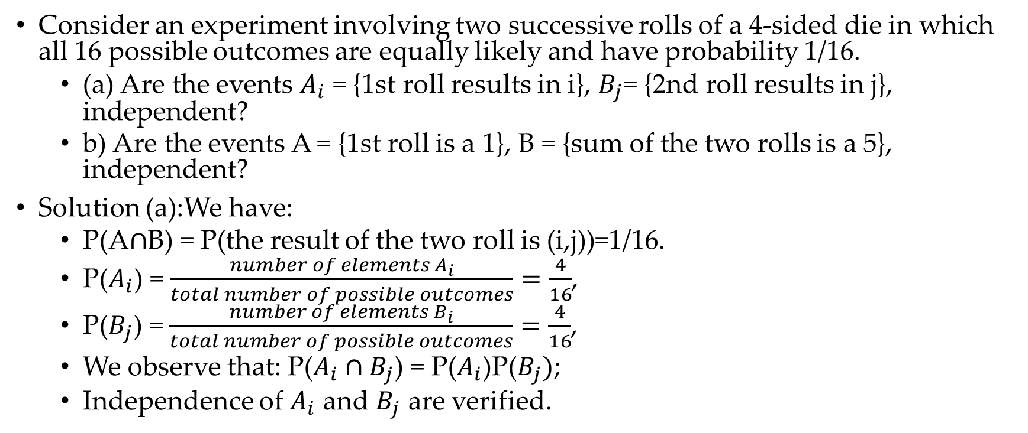
5.3 Independence: Example.
Consider an experiment involving two successive rolls of a 4-sided die in which all 16 possible outcomes are equally likely and have probability 1/16.
(a) Are the events $A_{i}$ = {1st roll results in i}, $B_{j}$= {2nd roll results in j}, independent?
b) Are the events A = {1st roll is a 1}, B = {sum of the two rolls is a 5}, independent?
Solution (a):We have:
P(A$∩$B) = P(the result of the two roll is (i,j))=1/16.
P($A_{i}$) = $\frac{number of elements A_{i}}{total number of possible outcomes}=\frac{4}{16}$,
P($B_{j}$) = $\frac{number of elements B_{i}}{total number of possible outcomes}=\frac{4}{16}$,
We observe that: P($A_{i}∩B_{j}$) = P($A_{i}$)P($B_{j})$;
Independence of $A_{i}$ and $B_{j}$ are verified.

Slide 41
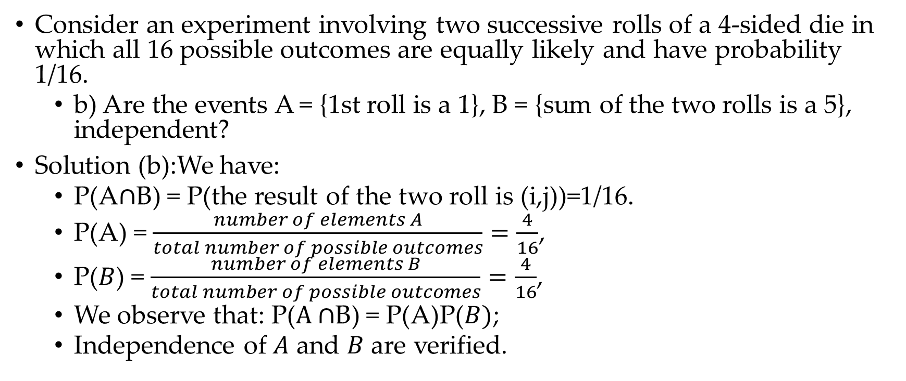
5.3 Independence: Example.
Consider an experiment involving two successive rolls of a 4-sided die in which all 16 possible outcomes are equally likely and have probability 1/16.
b) Are the events A = {1st roll is a 1}, B = {sum of the two rolls is a 5}, independent?
Solution (b):We have:
P(A$∩$B) = P(the result of the two roll is (i,j))=1/16.
P(A) = $\frac{number of elements A}{total number of possible outcomes}=\frac{4}{16}$,
P($B$) = $\frac{number of elements B}{total number of possible outcomes}=\frac{4}{16}$,
We observe that: P($A∩$B) = P(A)P($B)$;
Independence of $A$ and $B$ are verified.

Slide 42
5.4 Independence: Conditional.
Conditional Independence:
We noted earlier that the conditional probabilities of events, conditioned on a particular event, form a legitimate probability law.
We can thus talk about independence of various events with respect to this conditional law.
In particular, given an event G, the events E and F are called conditionally independent if
P(E ∩ F | G) = P(E | G)P(F | G)
In words, this relation states that if G is known to have occurred, the additional knowledge that F also occurred does not change the probability of E.

Slide 43
5.5 Independent Events Vs. Mutually Exclusive Event.
Independent Event-Example:
when rolling two dice, the outcome of the first die does not affect the outcome of the second die. The events "getting a 3 on the first die" and "getting a 4 on the second die" are independent events.
Mutually exclusive event-Example:
when drawing a card from a standard deck of playing cards, the events "drawing a red card" and "drawing a black card" are mutually exclusive because a card cannot be both red and black at the same time.
Moral of the story:
Independent events have no influence on each other’s outcomes, and their probabilities multiply when both events occur.
Mutually exclusive events cannot happen simultaneously, and there probabilities add up when either event occurs.

Slide 44
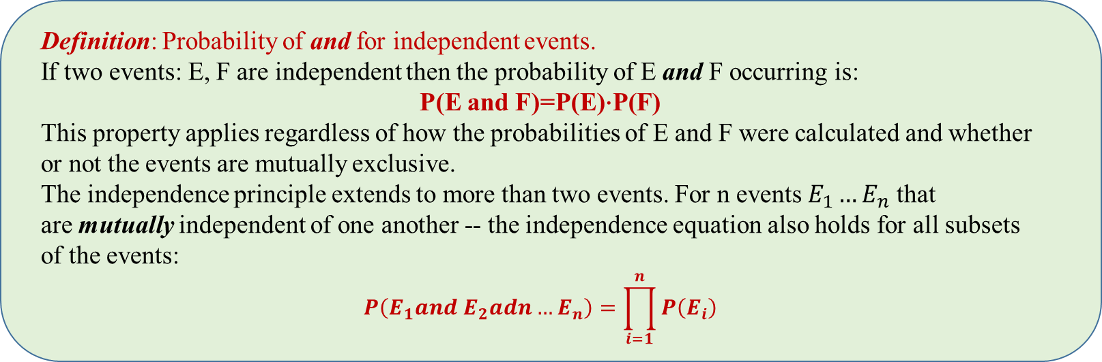
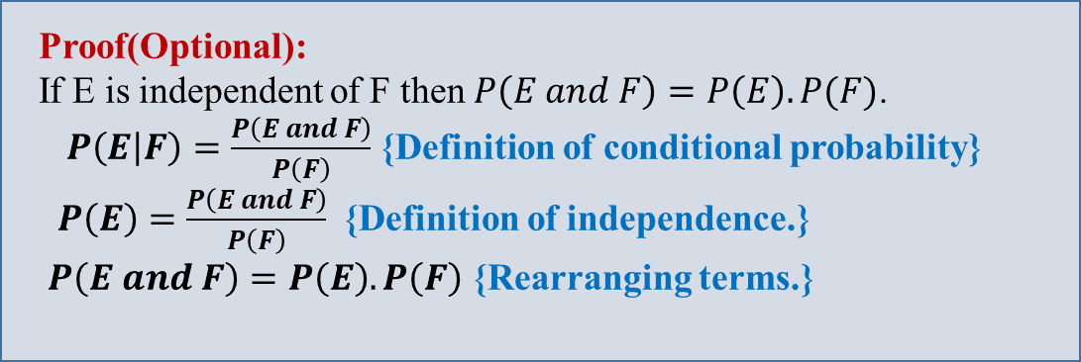
3.3 Calculating Probability of “and”
In slide 3.2 we discussed how to calculate Probability of “or”
Let’s see how to calculate Probability of “and”:
The probability of the and of two events, say E and F, written P(E and F), is the probability of both events happening:

Slide 45
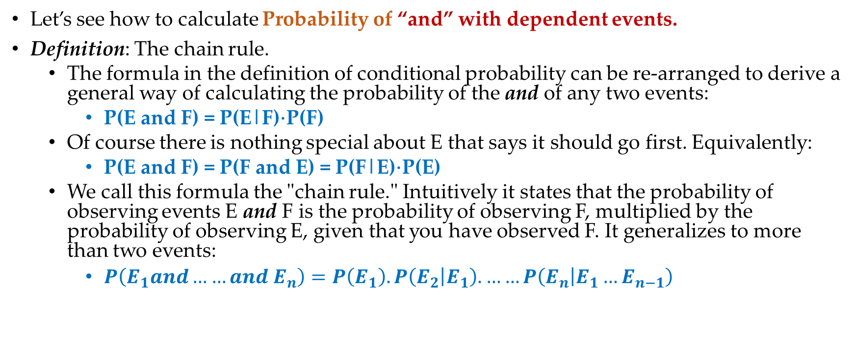
3.3 Calculating Probability of “and”
Let’s see how to calculate Probability of “and” with dependent events.
Definition: The chain rule.
The formula in the definition of conditional probability can be re-arranged to derive a general way of calculating the probability of the and of any two events:
P(E and F) = P(E|F)⋅P(F)
Of course there is nothing special about E that says it should go first. Equivalently:
P(E and F) = P(F and E) = P(F|E)⋅P(E)
We call this formula the "chain rule." Intuitively it states that the probability of observing events E and F is the probability of observing F, multiplied by the probability of observing E, given that you have observed F. It generalizes to more than two events:
$P\left(E_{1}and……and E_{n}\right)=P\left(E_{1}\right).P\left(E_{2} | E_{1}\right). ……P\left(E_{n} | E_{1}…E_{n−1}\right)$

Slide 46

Thank You any Question!!!

